Slide 1

Natural Language Processing
Yue Zhang
Westlake University

Slide 2
Overview
Week 2
Overview of NLP architecture
Data and Model
Review of background
Linear Models
Week 3
Week 4
Week 5
Week 6
Week 7
N-gram Language Models
Naïve Bayes
Generative Text Classification
Features
Document Representation
Discriminative Text Classification
Neuron
SGD
Entropy, Perplexity
Word Representation
HMM -- Generative Sturctured Prediction
CRF – Discriminative Structured Prediction
Neural Models
Week 8
Week 10
Week 12
MLP, Multi-Layer Perception
Neural N-gram LM and Word Embedding
Neural Structured Prediction
Sequence-to-sequence
Neural Recurrent Language Models
Week 9
Week 13
Sequence Representation
Neural Text Classification
Week 11
Sequence-level Pre-training
Pre-trained Models for Text Classification and other NLP tasks
Structured Representation
Large Language Models
Week 14
Week 15
Scaling, instruction following and LLMs
LLMs for NLP, AGI and beyond

Slide 3
Week 5
Neuron

Slide 4
Contents
5.1 Log-Linear Models
5.1.1 Training binary log-linear models
5.1.2 Training multi-class log-linear models
5.1.3 Using log-linear models for classification
5.2 SGD training of SVMs
5.2.1 Binary classification
5.2.2 A perceptron training objective function
5.3 A Generalized Linear Model for Classification
5.3.1 Unified Online Training
5.3.2 Loss Functions
5.3.3 Regularization
5.4 Combining with Multiple Models

Slide 5
Contents
5.1 Log-Linear Models
5.1.1 Training binary log-linear models
5.1.2 Training multi-class log-linear models
5.1.3 Using log-linear models for classification
5.2 SGD training of SVMs
5.2.1 Binary classification
5.2.2 A perceptron training objective function
5.3 A Generalized Linear Model for Classification
5.3.1 Unified Online Training
5.3.2 Loss Functions
5.3.3 Regularization
5.4 Combining with Multiple Models

Slide 6
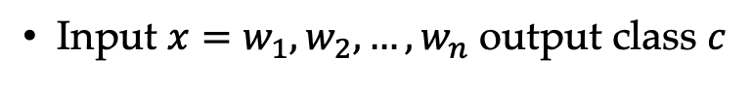
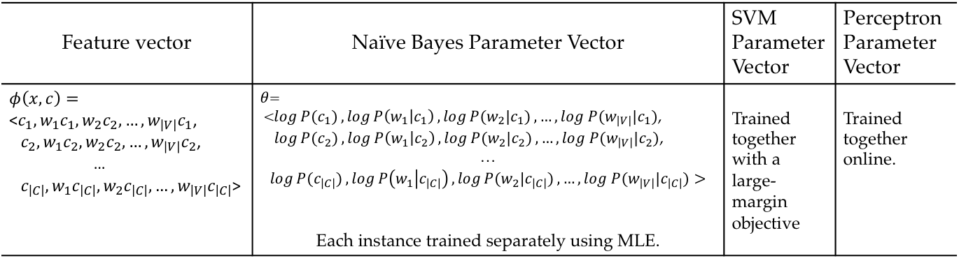
Review Linear Models
Input $x=w_{1},w_{2},…,w_{n}$ output class $c$
Feature vector | Naïve Bayes Parameter Vector | SVM Parameter Vector | Perceptron Parameter Vector
$$φ\left(x,c\right)=$$ <$c_{1},w_{1}c_{1},w_{2}c_{2},…,w_{\left|V\right|}c_{1}$, $c_{2},w_{1}c_{2},w_{2}c_{2},…,w_{\left|V\right|}c_{2}$, … $c_{\left|C\right|},w_{1}c_{\left|C\right|},w_{2}c_{\left|C\right|},…,w_{\left|V\right|}c_{\left|C\right|}$> | $θ$= <$\log{P(c_{1})},\log{P\left(w_{1} | c_{1}\right)},\log{P(w_{2}|c_{1})},…,log P(w_{\left|V\right|}|c_{1})$, $\log{P(c_{2})},\log{P\left(w_{1} | c_{2}\right)},\log{P(w_{2}|c_{2})},…,log P(w_{\left|V\right|}|c_{2})$, … $\log{P(c_{\left|C\right|})},\log{P\left(w_{1} | c_{\left|C\right|}\right)},\log{P(w_{2}|c_{\left|C\right|})},…,log P(w_{\left|V\right|}|c_{\left|C\right|})>$ Each instance trained separately using MLE. | Trained together with a large-margin objective | Trained together online.

Slide 7
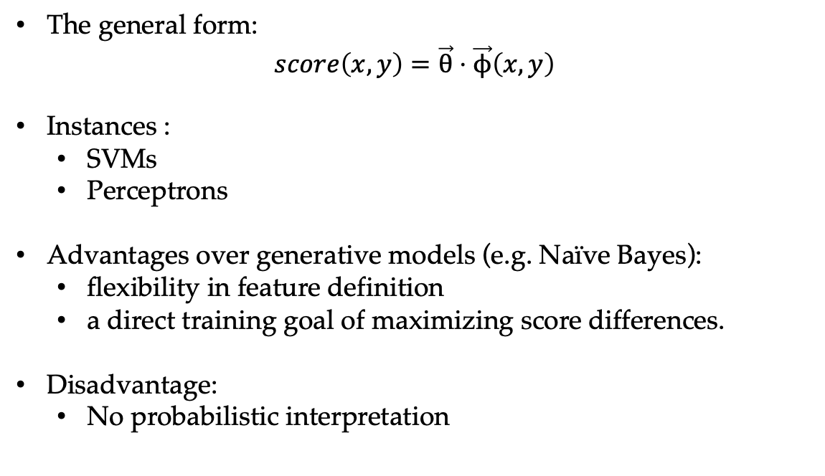
Discriminative Linear Classifiers
The general form:
$$score\left(x,y\right)=\vec{θ}⋅\vec{ϕ}\left(x,y\right)$$
Instances :
SVMs
Perceptrons
Advantages over generative models (e.g. Naïve Bayes):
flexibility in feature definition
a direct training goal of maximizing score differences.
Disadvantage:
No probabilistic interpretation
Notes:
What it Phi

Slide 8
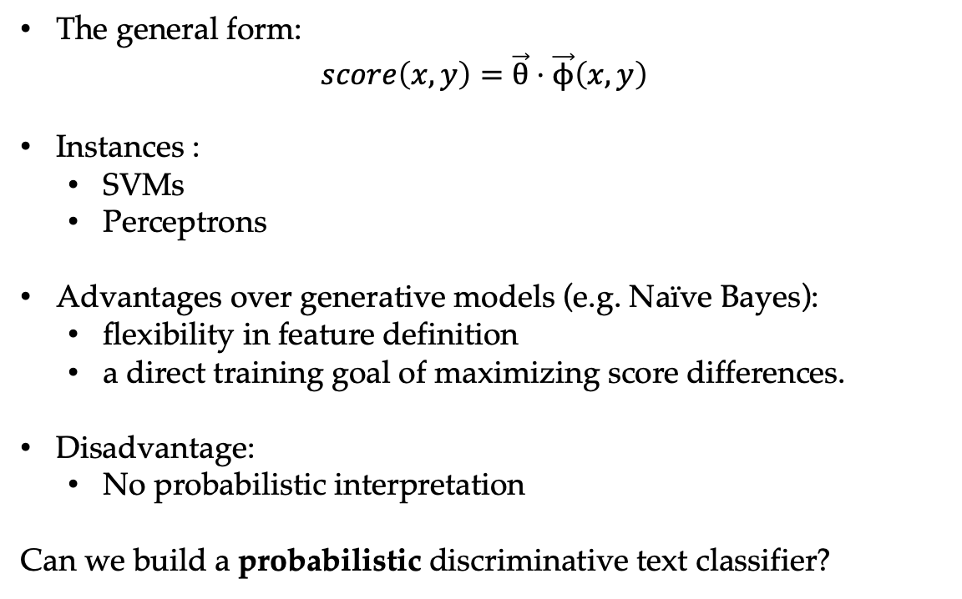
Discriminative Linear Classifiers
The general form:
$$score\left(x,y\right)=\vec{θ}⋅\vec{ϕ}\left(x,y\right)$$
Instances :
SVMs
Perceptrons
Advantages over generative models (e.g. Naïve Bayes):
flexibility in feature definition
a direct training goal of maximizing score differences.
Disadvantage:
No probabilistic interpretation
Can we build a probabilistic discriminative text classifier?
Notes:
What it Phi

Slide 9
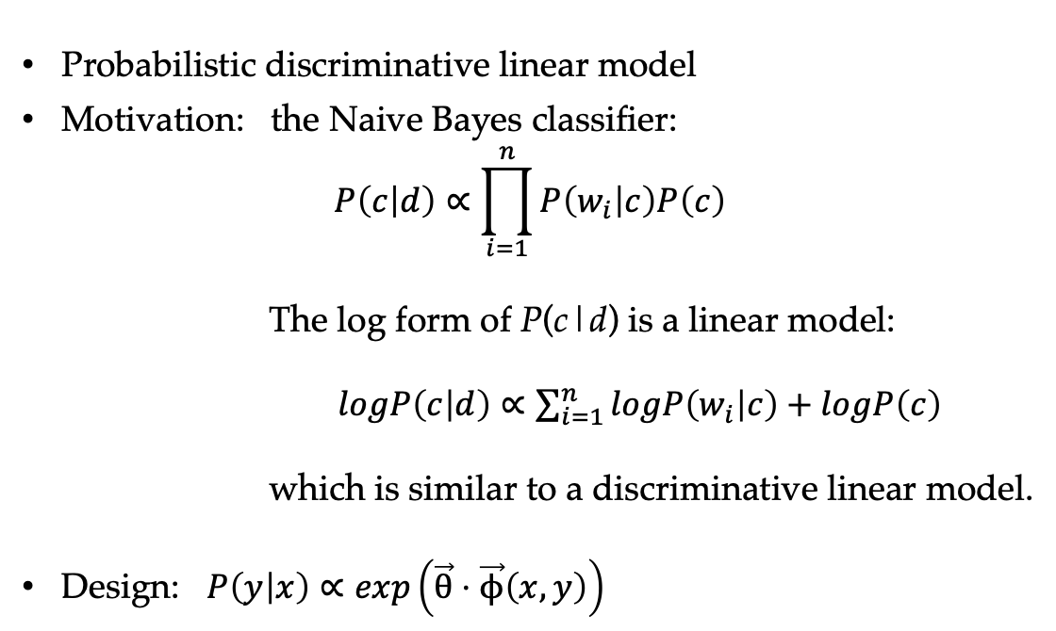
Log-linear Models
Probabilistic discriminative linear model
Motivation: the Naive Bayes classifier:
$$P\left(c | d\right)∝\prod_{i=1}^{n}{P\left(w_{i} | c\right)P\left(c\right)}$$
The log form of P(c|d) is a linear model:
$logP\left(c | d\right)∝\sum_{i=1}^{n}{logP\left(w_{i} | c\right)}+logP\left(c\right)$
which is similar to a discriminative linear model.
Design: $P\left(y | x\right)∝\exp\left(\vec{θ}⋅\vec{ϕ}\left(x,y\right)\right)$

Slide 10
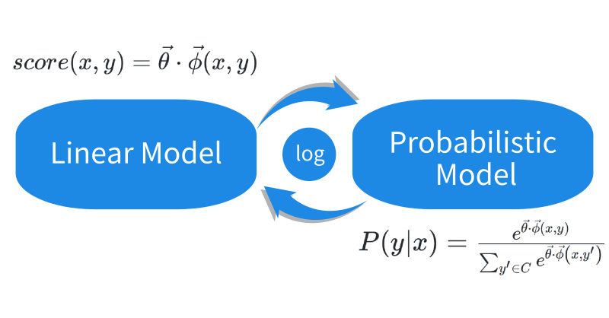

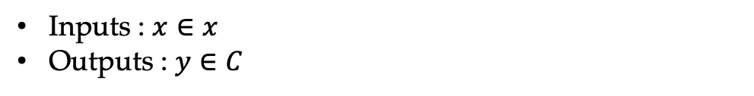
Log-linear Model for Multi-class Classification
Inputs : $x∈x$
Outputs : $y∈C$
which can also be described as:

Slide 11
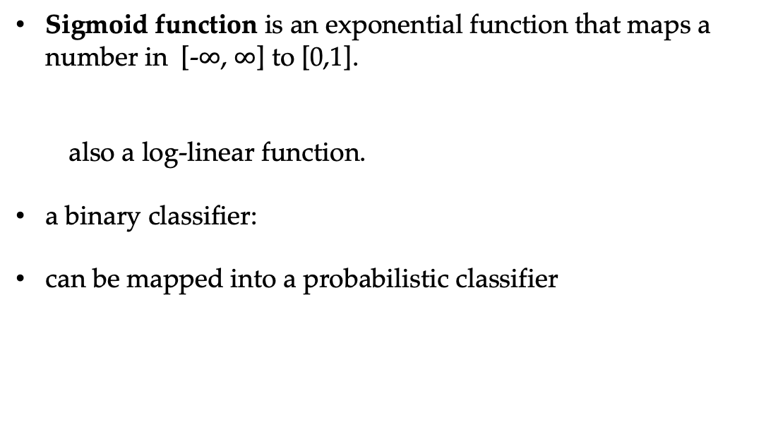
Log-linear Model for Multi-class Classification
Sigmoid function is an exponential function that maps a number in [-$∞$, $∞$] to [0,1].
also a log-linear function.
a binary classifier:
can be mapped into a probabilistic classifier

Slide 12
Log-linear Model Summary
Modeling target:
Parameterization
binary classifier:
multi-class classifier:

Slide 13
Contents
5.1 Log-Linear Models
5.1.1 Training binary log-linear models
5.1.2 Training multi-class log-linear models
5.1.3 Using log-linear models for classification
5.2 SGD training of SVMs
5.2.1 Binary classification
5.2.2 A perceptron training objective function
5.3 A Generalized Linear Model for Classification
5.3.1 Unified Online Training
5.3.2 Loss Functions
5.3.3 Regularization
5.4 Combining with Multiple Models

Slide 14
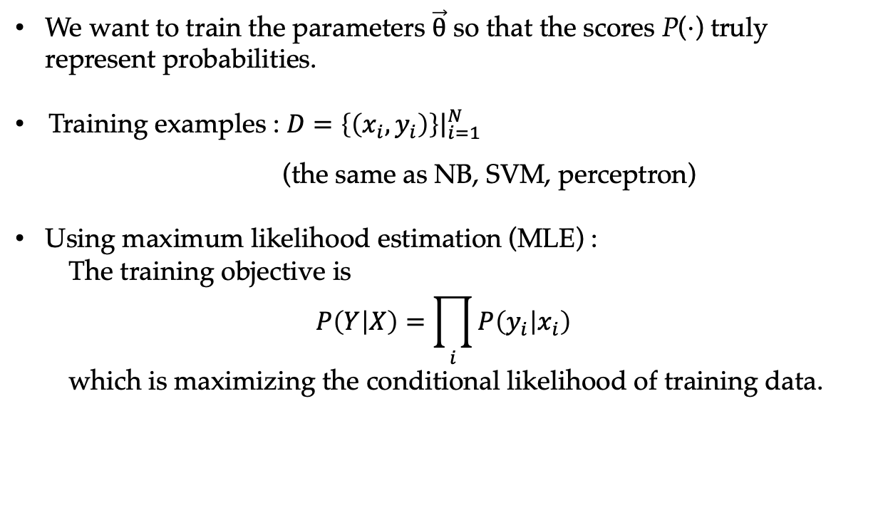
Training Log-linear Models
We want to train the parameters $\vec{θ}$ so that the scores P($⋅$) truly represent probabilities.
Training examples : $D={\left.\left\{\left(x_{i},y_{i}\right)\right\}\right|}_{i=1}^{N}$
(the same as NB, SVM, perceptron)
Using maximum likelihood estimation (MLE) :
The training objective is
$$P\left(Y | X\right)=\prod_{i}{P\left(y_{i} | x_{i}\right)}$$
which is maximizing the conditional likelihood of training data.

Slide 15
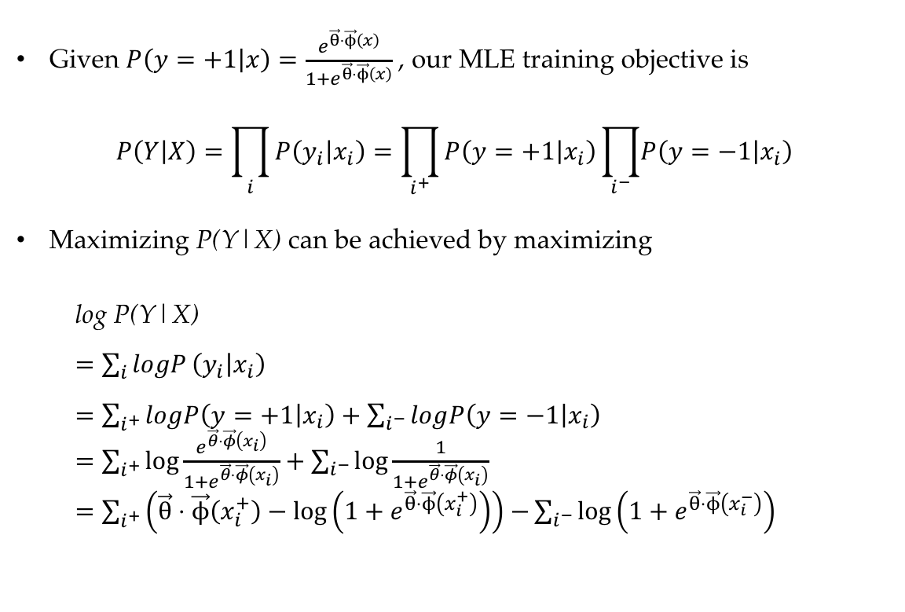
Training Binary Log-linear Models
Given $P\left(y=+1 | x\right)=\frac{e^{\vec{θ}⋅\vec{ϕ}\left(x\right)}}{1+e^{\vec{θ}⋅\vec{ϕ}\left(x\right)}}$ , our MLE training objective is
$$P\left(Y | X\right)=\prod_{i}{P\left(y_{i} | x_{i}\right)}=\prod_{i^{+}}{P\left(y=+1 | x_{i}\right)\prod_{i^{−}}{\left.P\left(y=−1 | x_{i}\right)\right.}}$$
Maximizing P(Y|X) can be achieved by maximizing
log P(Y|X)
$=\sum_{i}{logP}\left(y_{i} | x_{i}\right)$
$=\sum_{i^{+}}{logP\left(y=+1 | x_{i}\right)}+\sum_{i^{−}}{log\left.P\left(y=−1 | x_{i}\right)\right.}$
$=\sum_{i^{+}}{\log{\frac{e^{\vec{θ}⋅\vec{φ}\left(x_{i}\right)}}{1+e^{\vec{θ}⋅\vec{φ}\left(x_{i}\right)}}}}+\sum_{i^{−}}{\log{\frac{1}{1+e^{\vec{θ}⋅\vec{φ}\left(x_{i}\right)}}}}$
$=\sum_{i^{+}}{\left(\vec{θ}⋅\vec{ϕ}\left(x_{i}^{+}\right)−\log\left(1+e^{\vec{θ}⋅\vec{ϕ}\left(x_{i}^{+}\right)}\right)\right)}$ $−\sum_{i^{−}}{\log\left(1+e^{\vec{θ}⋅\vec{ϕ}\left(x_{i}^{−}\right)}\right)}$

Slide 16
Gradient Descent
For log-linear model, the gradient of the objective is :

Slide 17
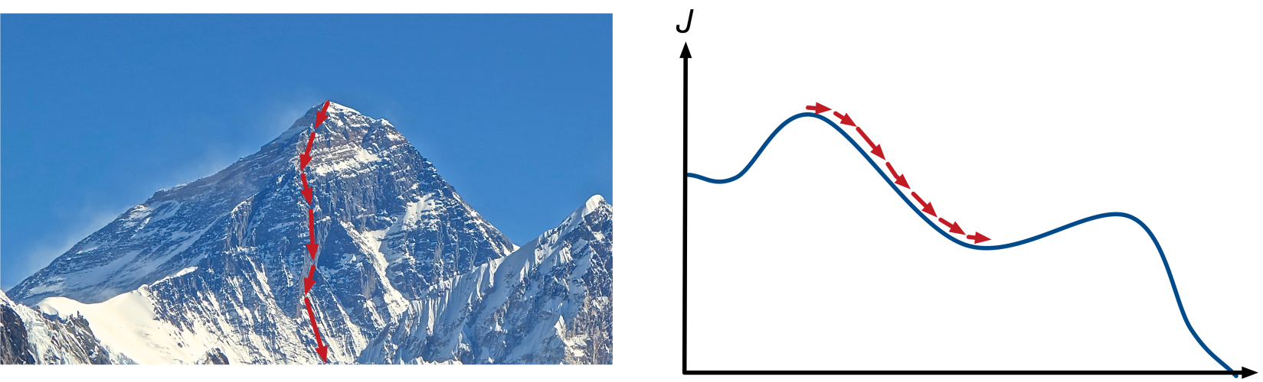
Gradient Descent
For log-linear model, the gradient of the objective is :

Slide 18
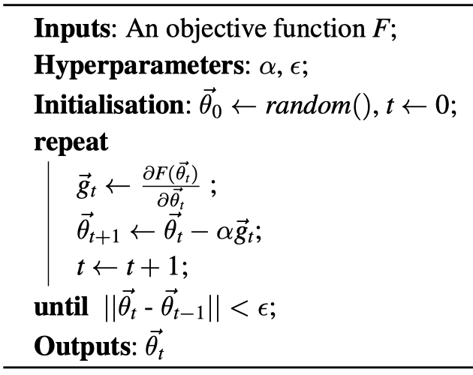
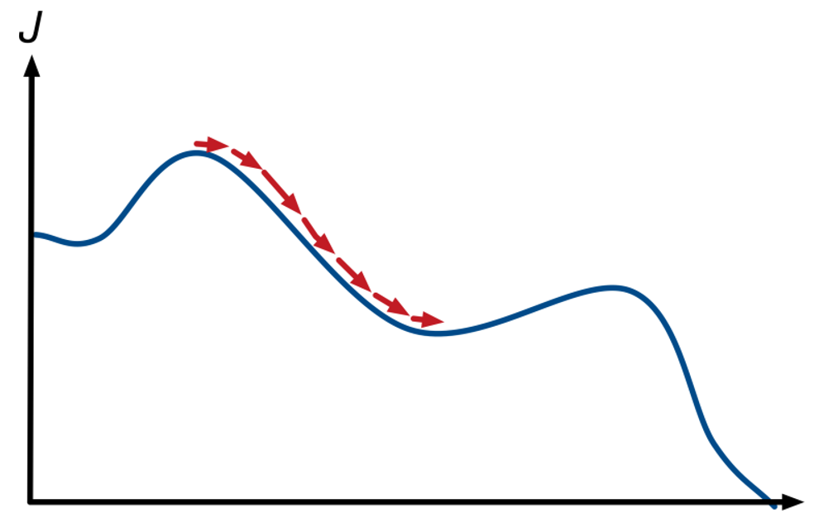
Gradient Descent
A simple numerical solution to the minimization of convex functions.
Gradient Descent

Slide 19
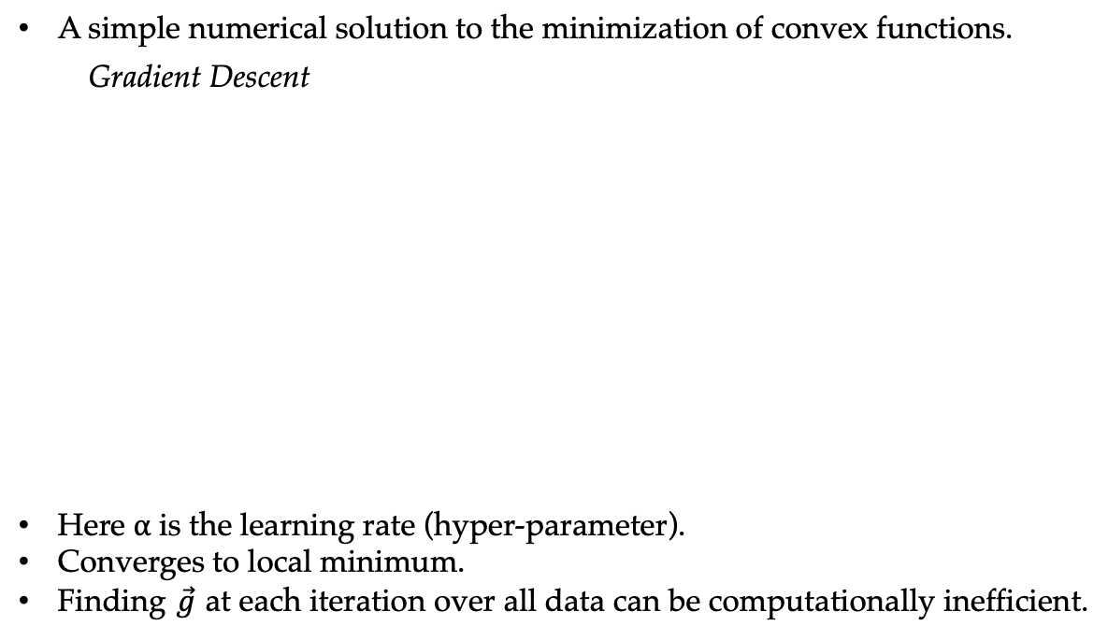
Gradient Descent
A simple numerical solution to the minimization of convex functions.
Gradient Descent
Here $α$ is the learning rate (hyper-parameter).
Converges to local minimum.
Finding $\vec{g}$ at each iteration over all data can be computationally inefficient.

Slide 20
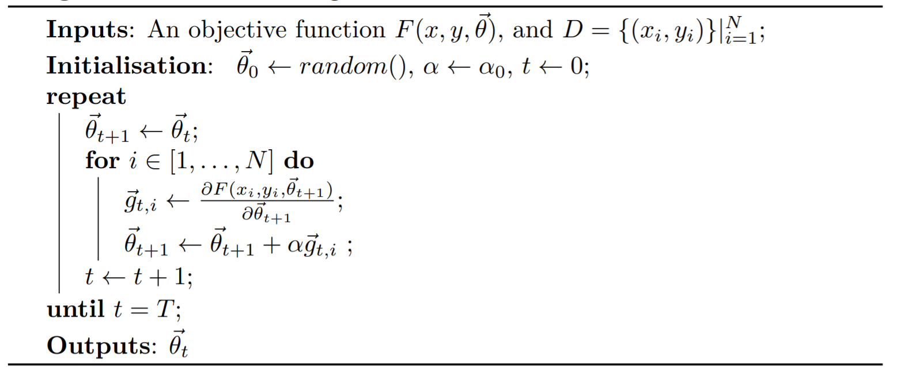
Stochastic Gradient Descent (SGD)
Update parameters after every instance instead.
Stochastic Gradient Descent
SGD updates model parameters more frequently, and converge much faster than gradient descents.
Approximates GD, empirically working competitively.
Notes:
Algorithm 4.1-4.3

Slide 21
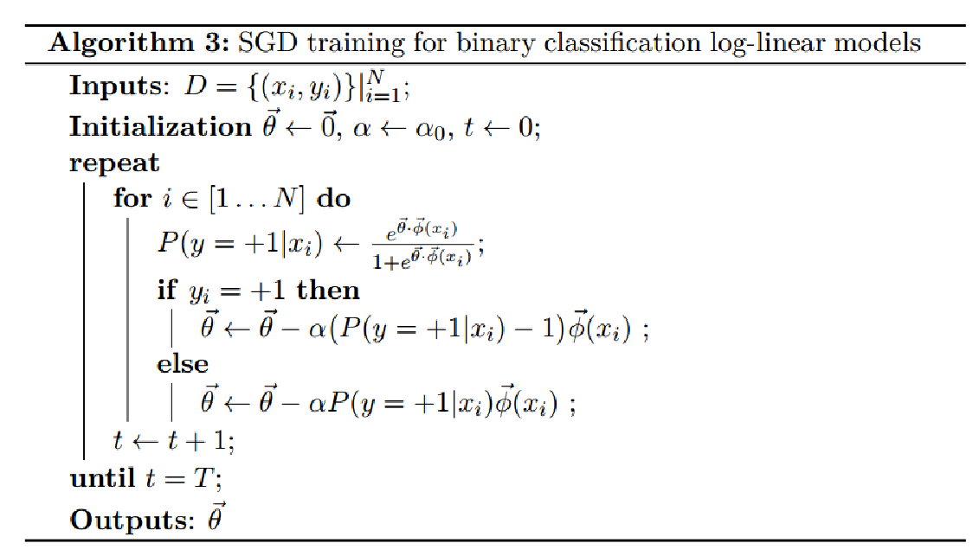
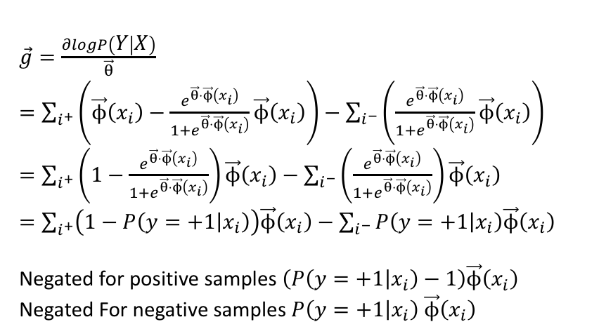
Stochastic Gradient Descent (SGD)
SGD for binary classification log-linear model
$\vec{g}=\frac{∂logP\left(Y | X\right)}{\vec{θ}}$
$=\sum_{i^{+}}{\left(\vec{ϕ}\left(x_{i}\right)−\frac{e^{\vec{θ}⋅\vec{ϕ}\left(x_{i}\right)}}{1+e^{\vec{θ}⋅\vec{ϕ}\left(x_{i}\right)}}\vec{ϕ}\left(x_{i}\right)\right)}−\sum_{i^{−}}{\left(\frac{e^{\vec{θ}⋅\vec{ϕ}\left(x_{i}\right)}}{1+e^{\vec{θ}⋅\vec{ϕ}\left(x_{i}\right)}}\vec{ϕ}\left(x_{i}\right)\right)}$
$=\sum_{i^{+}}{\left(1−\frac{e^{\vec{θ}⋅\vec{ϕ}\left(x_{i}\right)}}{1+e^{\vec{θ}⋅\vec{ϕ}\left(x_{i}\right)}}\right)\vec{ϕ}\left(x_{i}\right)}−\sum_{i^{−}}{\left(\frac{e^{\vec{θ}⋅\vec{ϕ}\left(x_{i}\right)}}{1+e^{\vec{θ}⋅\vec{ϕ}\left(x_{i}\right)}}\right)\vec{ϕ}\left(x_{i}\right)}$
$=\sum_{i^{+}}{\left(1−P\left(y=+1 | x_{i}\right)\right)\vec{ϕ}\left(x_{i}\right)}−\sum_{i^{−}}{P\left(y=+1 | x_{i}\right)\vec{ϕ}\left(x_{i}\right)}$
Negated for positive samples $\left(P\left(y=+1 | x_{i}\right)−1\right)\vec{ϕ}\left(x_{i}\right)$
Negated For negative samples $P\left(y=+1 | x_{i}\right)$ $\vec{ϕ}\left(x_{i}\right)$

Slide 22
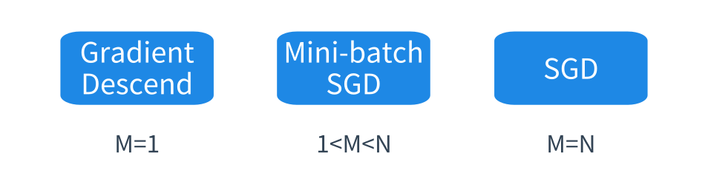
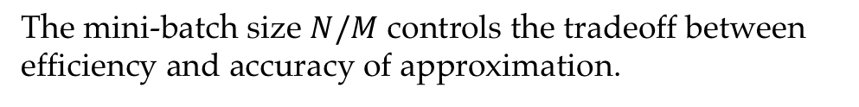
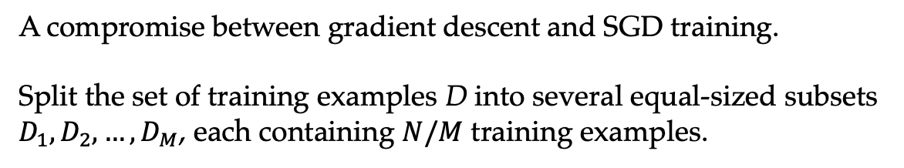
Mini-batch SGD
A compromise between gradient descent and SGD training.
Split the set of training examples D into several equal-sized subsets $D_{1},D_{2},…,D_{M}$, each containing $N/M$ training examples.
The mini-batch size $N/M$ controls the tradeoff between efficiency and accuracy of approximation.

Slide 23
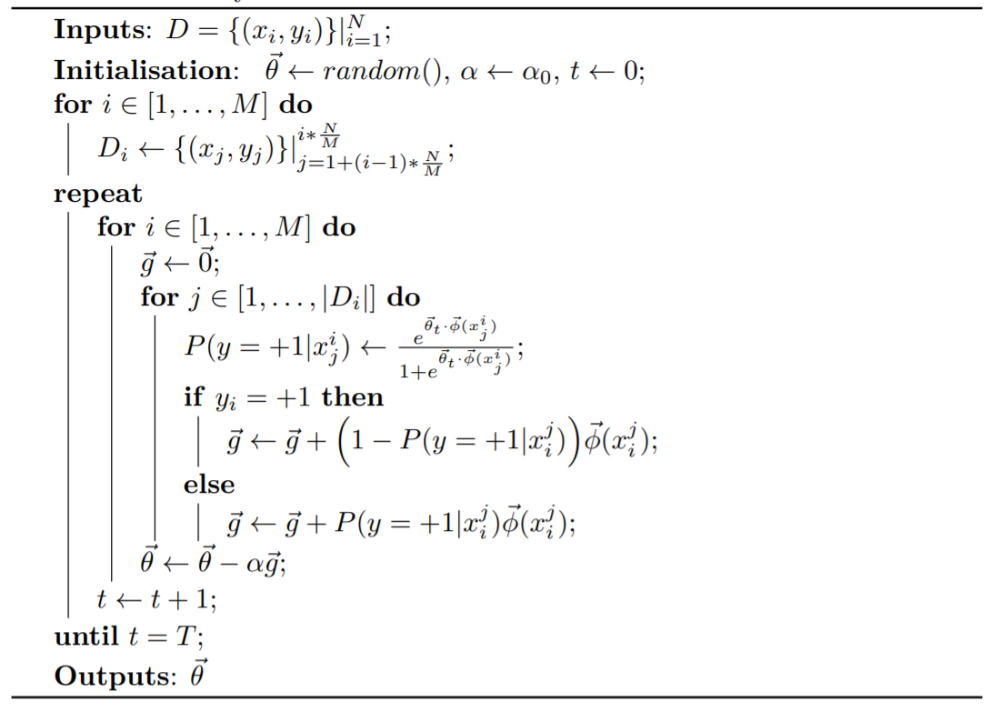
Mini-batch SGD
Mini-batch gradient descent for binary classification
SGD for binary classification log-linear model

Slide 24
Contents
5.1 Log-Linear Models
5.1.1 Training binary log-linear models
5.1.2 Training multi-class log-linear models
5.1.3 Using log-linear models for classification
5.2 SGD training of SVMs
5.2.1 Binary classification
5.2.2 A perceptron training objective function
5.3 A Generalized Linear Model for Classification
5.3.1 Unified Online Training
5.3.2 Loss Functions
5.3.3 Regularization
5.4 Combining with Multiple Models

Slide 25
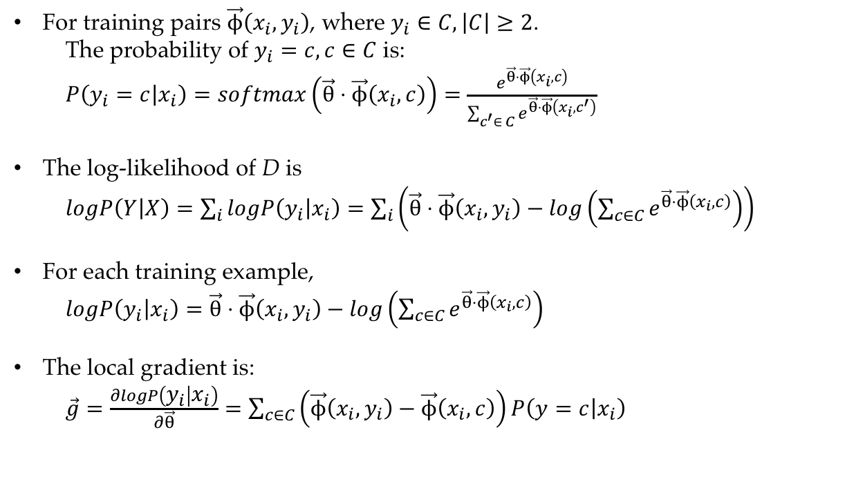
Training Multi-class Log-linear Models
For training pairs $\vec{ϕ}\left(x_{i},y_{i}\right)$, where $y_{i}∈C,\left|C\right|≥2$.
The probability of $y_{i}=c,c∈C$ is:
$P\left(y_{i}=c | x_{i}\right)=softmax\left(\vec{θ}⋅\vec{ϕ}\left(x_{i},c\right)\right)=\frac{e^{\vec{θ}⋅\vec{ϕ}\left(x_{i},c\right)}}{\sum_{c^{′}∈ C}{e^{\vec{θ}⋅\vec{ϕ}\left(x_{i},c^{′}\right)}}}$
The log-likelihood of D is
$logP\left(Y | X\right)=\sum_{i}{logP\left(y_{i} | x_{i}\right)}=\sum_{i}{\left(\vec{θ}⋅\vec{ϕ}\left(x_{i},y_{i}\right)−log\left(\sum_{c∈C}{e^{\vec{θ}⋅\vec{ϕ}\left(x_{i},c\right)}}\right)\right)}$
For each training example,
$logP\left(y_{i} | x_{i}\right)=\vec{θ}⋅\vec{ϕ}\left(x_{i},y_{i}\right)−log\left(\sum_{c∈C}{e^{\vec{θ}⋅\vec{ϕ}\left(x_{i},c\right)}}\right)$
The local gradient is:
$\vec{g}=\frac{∂logP\left(y_{i} | x_{i}\right)}{∂\vec{θ}}=\sum_{c∈C}{\left(\vec{ϕ}\left(x_{i},y_{i}\right)−\vec{ϕ}\left(x_{i},c\right)\right)P\left(y=c | x_{i}\right)}$

Slide 26
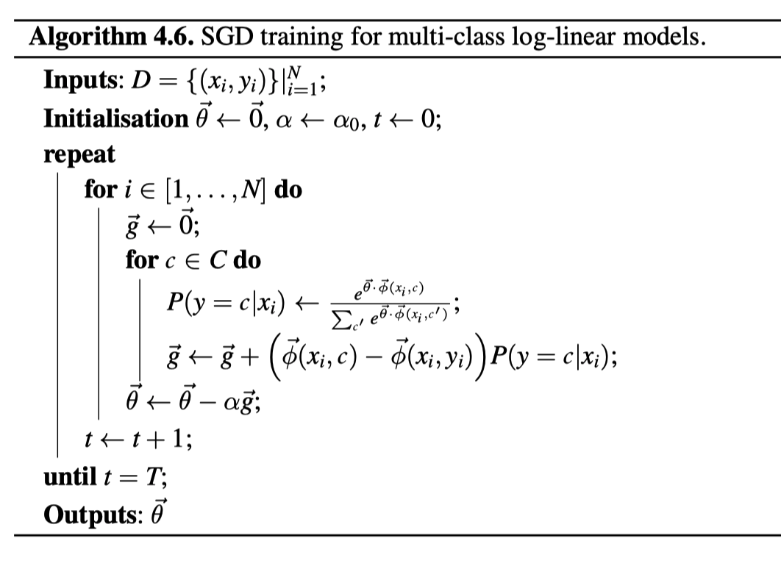
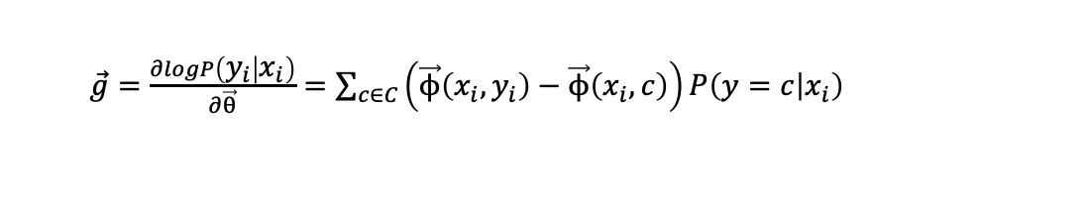
Training Multi-class Log-linear Models
SGD
SGD training for multi-class log-linear models
$\vec{g}=\frac{∂logP\left(y_{i} | x_{i}\right)}{∂\vec{θ}}=\sum_{c∈C}{\left(\vec{ϕ}\left(x_{i},y_{i}\right)−\vec{ϕ}\left(x_{i},c\right)\right)P\left(y=c | x_{i}\right)}$

Slide 27
Contents
5.1 Log-Linear Models
5.1.1 Training binary log-linear models
5.1.2 Training multi-class log-linear models
5.1.3 Using log-linear models for classification
5.2 SGD training of SVMs
5.2.1 Binary classification
5.2.2 A perceptron training objective function
5.3 A Generalized Linear Model for Classification
5.3.1 Unified Online Training
5.3.2 Loss Functions
5.3.3 Regularization
5.4 Combining with Multiple Models

Slide 28
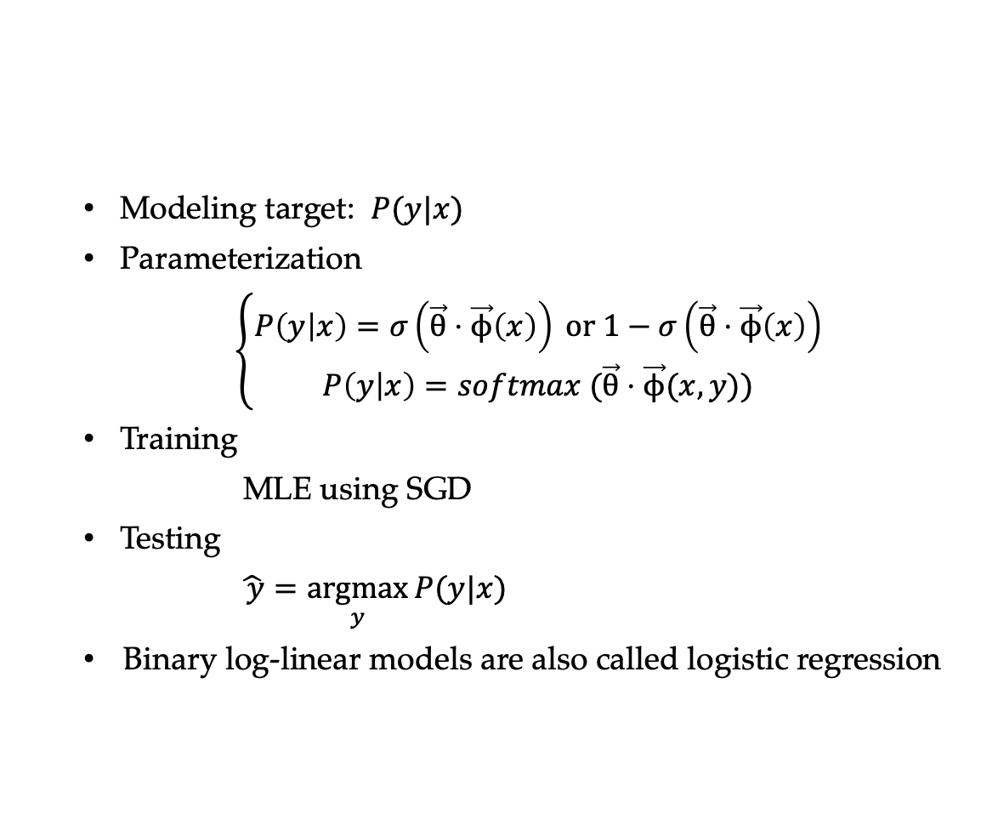
Review Log-linear Model
Modeling target: $P(y|x)$
Parameterization
$\left\{\begin{aligned}P\left(y | x\right)=σ\left(\vec{θ}⋅\vec{ϕ}\left(x\right)\right) or 1−σ\left(\vec{θ}⋅\vec{ϕ}\left(x\right)\right) \\ P\left(y | x\right)=softmax (\vec{θ}⋅\vec{ϕ}(x,y))\end{aligned}\right.$
Training
MLE using SGD
Testing
$\hat{ y}=\underset{y}{argmax}{P(y|x)}$
Binary log-linear models are also called logistic regression

Slide 29
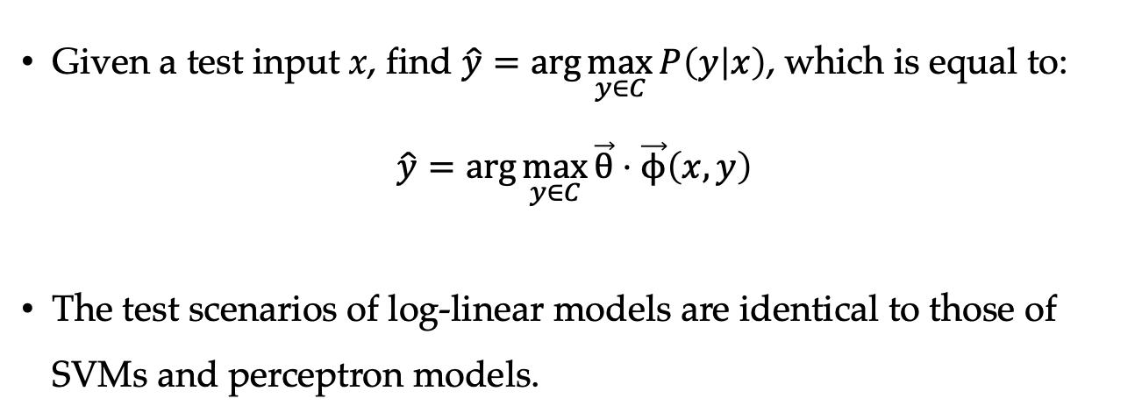
Test Scenario of Log-linear Models
Given a test input x, find $\hat{y}=\arg{\max_{y∈C}{P\left(y | x\right)}}$, which is equal to:
$$\hat{y}=\arg{\max_{y∈C}{\vec{θ}⋅\vec{ϕ}\left(x,y\right)}}$$
The test scenarios of log-linear models are identical to those of SVMs and perceptron models.

Slide 30
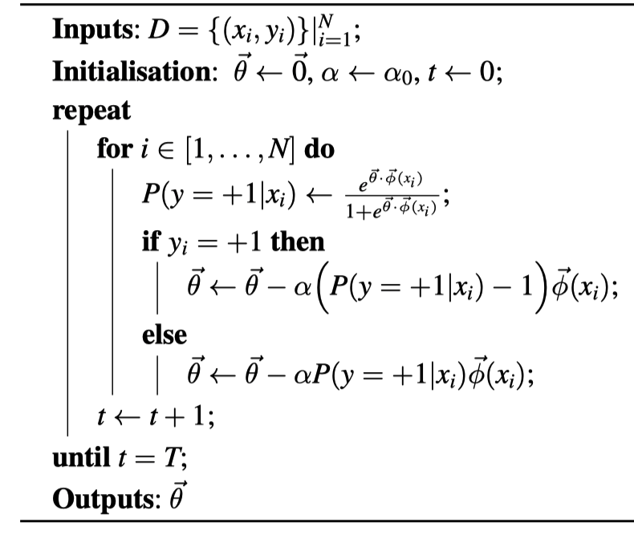
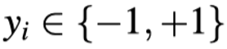
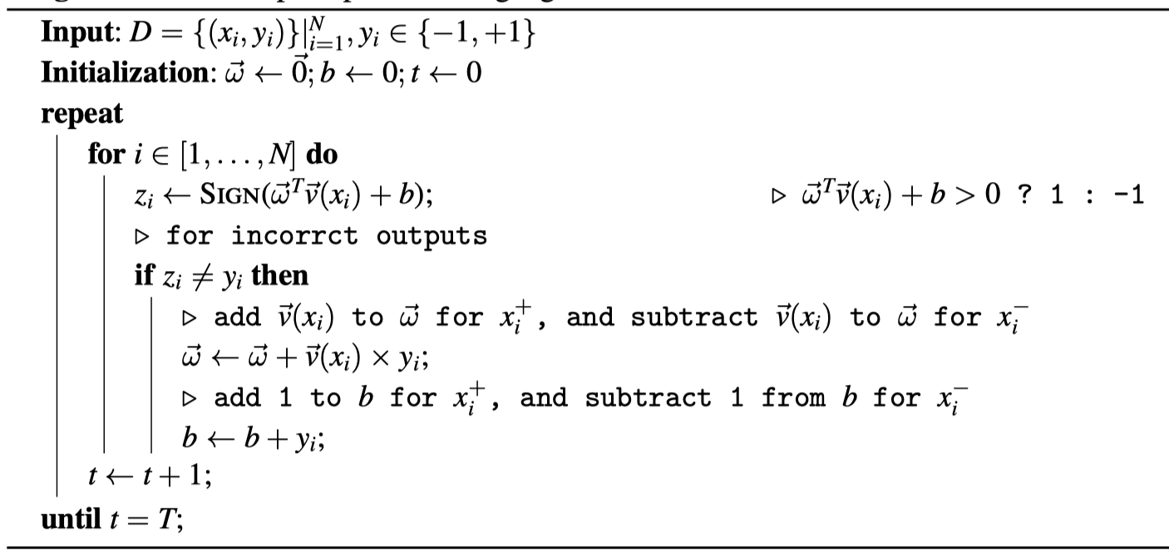
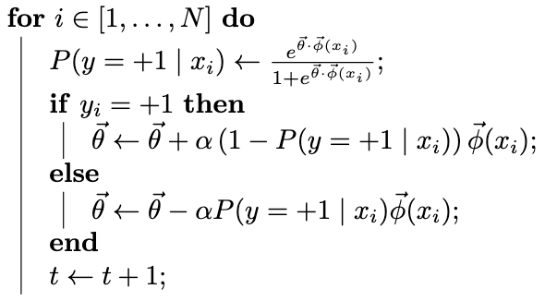
Comparing with Perceptron for Binary Classification
binary log-linear models binary perceptron models
No condition for update, update has weights.
Results in probability intepretation.

Slide 31
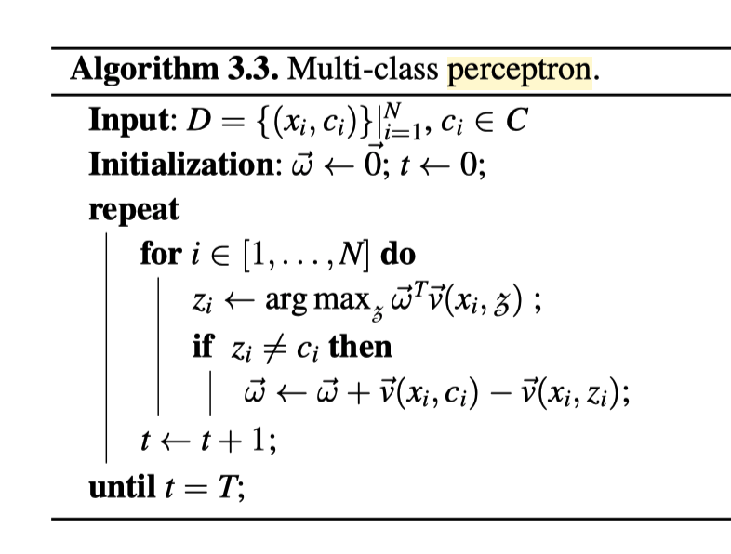
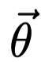
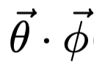
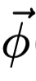
Comparing with Perceptron for Multi-class Classification
multi-class log-linear models multi-class perceptron models
No condition for update, update has weights.

Slide 32
Contents
5.1 Log-Linear Models
5.1.1 Training binary log-linear models
5.1.2 Training multi-class log-linear models
5.1.3 Using log-linear models for classification
5.2 SGD training of SVMs
5.2.1 Binary classification
5.2.2 A perceptron training objective function
5.3 A Generalized Linear Model for Classification
5.3.1 Unified Online Training
5.3.2 Loss Functions
5.3.3 Regularization
5.4 Combining with Multiple Models

Slide 33
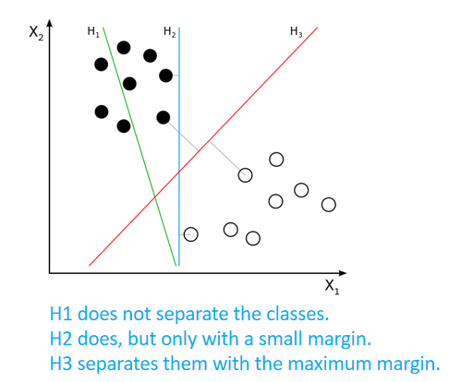
SVM Recap
A linear model for binary classification in vector space.
To maximize margin (distances form support vectors to hyperplane)
minimize
To minimize violation, i.e., cases that violate support vector margins.
minimize
SVM hyperplane
Support vectors
Margins

Slide 34
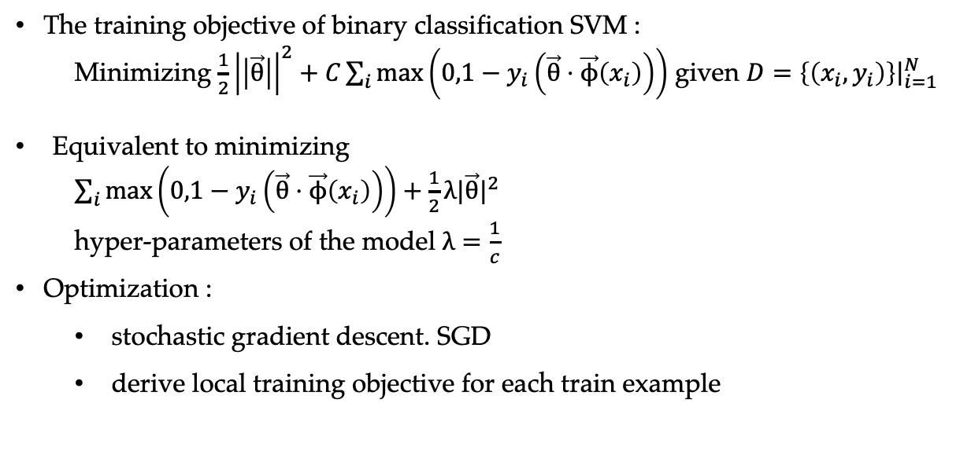
Binary Classification SVM
The training objective of binary classification SVM :
Minimizing $\frac{1}{2}{\left|\left|\vec{θ}\right|\right|}^{2}+C\sum_{i}{\max\left(0,1−y_{i}\left(\vec{θ}⋅\vec{ϕ}\left(x_{i}\right)\right)\right)}$ given $D={\left.\left\{\left(x_{i},y_{i}\right)\right\}\right|}_{i=1}^{N}$
Equivalent to minimizing
$\sum_{i}{\max\left(0,1−y_{i}\left(\vec{θ}⋅\vec{ϕ}\left(x_{i}\right)\right)\right)}+\frac{1}{2}λ|\vec{θ}|^{2}$
hyper-parameters of the model $λ=\frac{1}{c}$
Optimization :
stochastic gradient descent. SGD
derive local training objective for each train example
Notes:
Add intuition, plot figure
Slag variable
Maximize margin
Minimize violation
Max function not differentiable

Slide 35
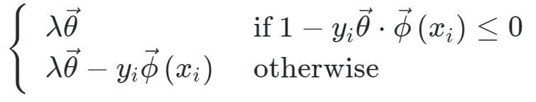
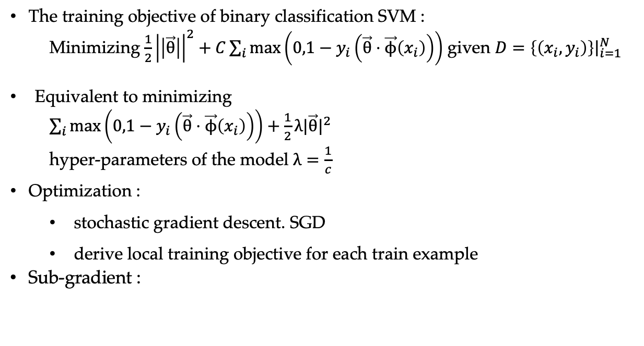
Binary Classification SVM
The training objective of binary classification SVM :
Minimizing $\frac{1}{2}{\left|\left|\vec{θ}\right|\right|}^{2}+C\sum_{i}{\max\left(0,1−y_{i}\left(\vec{θ}⋅\vec{ϕ}\left(x_{i}\right)\right)\right)}$ given $D={\left.\left\{\left(x_{i},y_{i}\right)\right\}\right|}_{i=1}^{N}$
Equivalent to minimizing
$\sum_{i}{\max\left(0,1−y_{i}\left(\vec{θ}⋅\vec{ϕ}\left(x_{i}\right)\right)\right)}+\frac{1}{2}λ|\vec{θ}|^{2}$
hyper-parameters of the model $λ=\frac{1}{c}$
Optimization :
stochastic gradient descent. SGD
derive local training objective for each train example
Sub-gradient :
Notes:
Add intuition, plot figure
Slag variable
Maximize margin
Minimize violation
Max function not differentiable

Slide 36
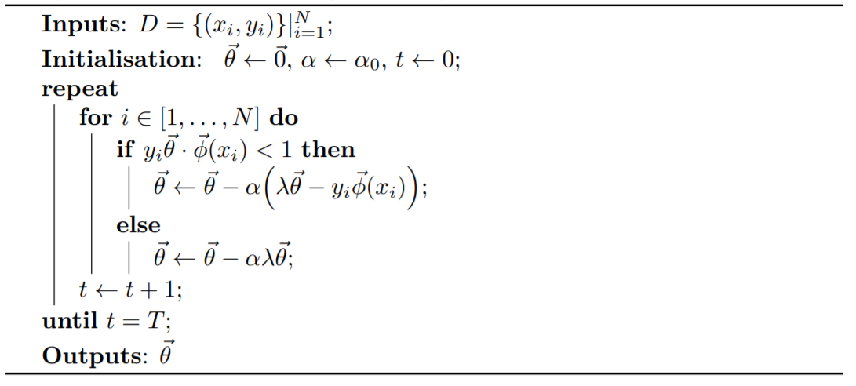
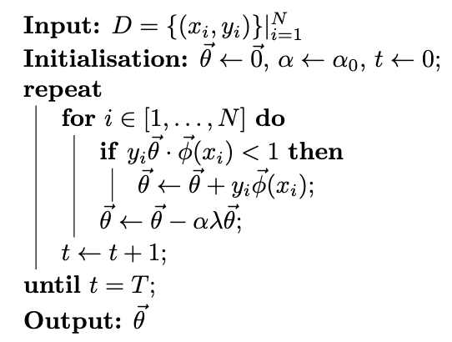
Binary Classification SVM
SGD
SGD training for binary classification SVM

Slide 37
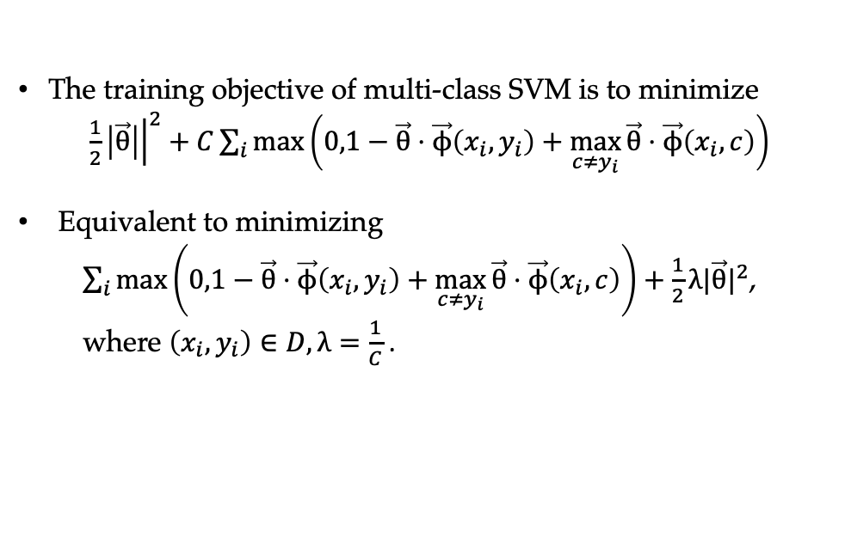
Multi-class Classification SVM
The training objective of multi-class SVM is to minimize
$\frac{1}{2}{\left.\left|\vec{θ}\right|\right|}^{2}+C\sum_{i}{\max\left(0,1−\vec{θ}⋅\vec{ϕ}\left(x_{i},y_{i}\right)+\max_{c≠y_{i}}{\vec{θ}⋅\vec{ϕ}\left(x_{i},c\right)}\right)}$
Equivalent to minimizing
$\sum_{i}{\max\left(0,1−\vec{θ}⋅\vec{ϕ}\left(x_{i},y_{i}\right)+\max_{c≠y_{i}}{\vec{θ}}⋅\vec{ϕ}\left(x_{i},c\right)\right)}+\frac{1}{2}λ|\vec{θ}|^{2}$,
where $\left(x_{i},y_{i}\right)∈D,λ=\frac{1}{C}$ .

Slide 38
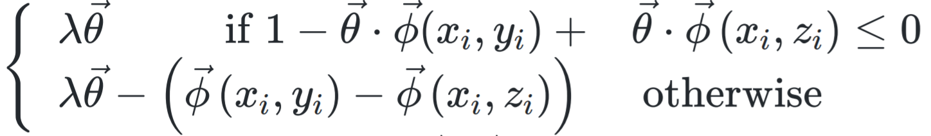
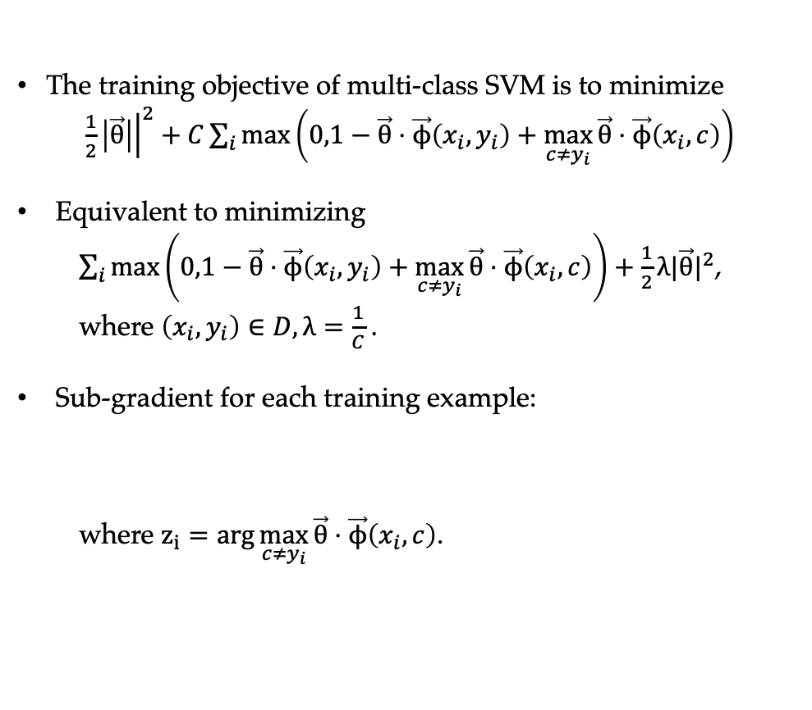
Multi-class Classification SVM
The training objective of multi-class SVM is to minimize
$\frac{1}{2}{\left.\left|\vec{θ}\right|\right|}^{2}+C\sum_{i}{\max\left(0,1−\vec{θ}⋅\vec{ϕ}\left(x_{i},y_{i}\right)+\max_{c≠y_{i}}{\vec{θ}⋅\vec{ϕ}\left(x_{i},c\right)}\right)}$
Equivalent to minimizing
$\sum_{i}{\max\left(0,1−\vec{θ}⋅\vec{ϕ}\left(x_{i},y_{i}\right)+\max_{c≠y_{i}}{\vec{θ}}⋅\vec{ϕ}\left(x_{i},c\right)\right)}+\frac{1}{2}λ|\vec{θ}|^{2}$,
where $\left(x_{i},y_{i}\right)∈D,λ=\frac{1}{C}$ .
Sub-gradient for each training example:
where $z_{i}=arg\max_{c≠y_{i}}{\vec{θ}⋅\vec{ϕ}\left(x_{i},c\right)}$.

Slide 39
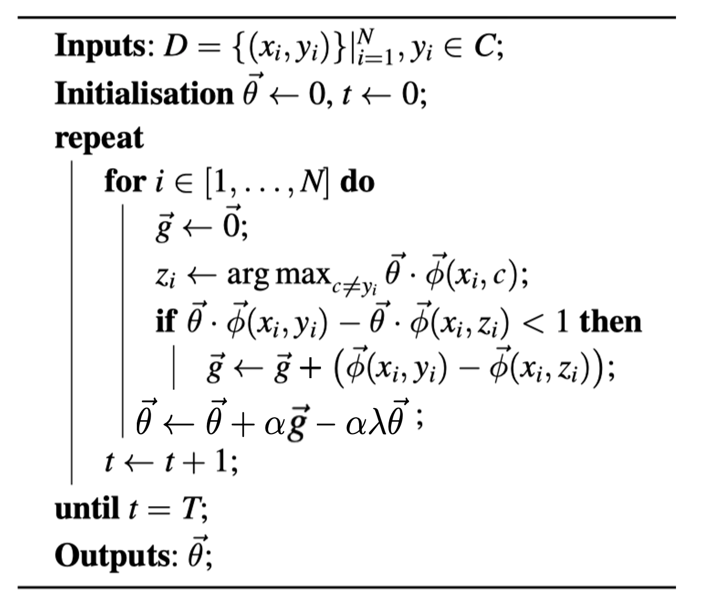
Multi-class Classification SVM
SGD
SGD training for multi-class classification SVM

Slide 40
Contents
5.1 Log-Linear Models
5.1.1 Training binary log-linear models
5.1.2 Training multi-class log-linear models
5.1.3 Using log-linear models for classification
5.2 SGD training of SVMs
5.2.1 Binary classification
5.2.2 A perceptron training objective function
5.3 A Generalized Linear Model for Classification
5.3.1 Unified Online Training
5.3.2 Loss Functions
5.3.3 Regularization
5.4 Combining with Multiple Models

Slide 41
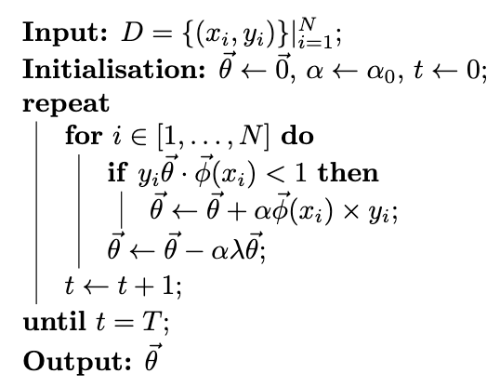
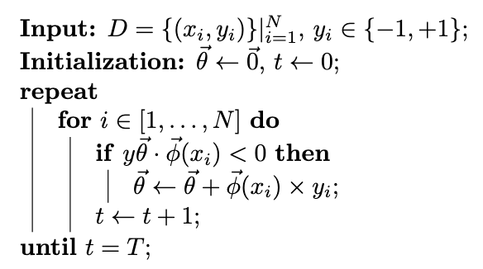
Comparing with Perceptron Binary Classification
binary SVM models binary perceptron models
Condition different (SVM more strict); has additional

Slide 42
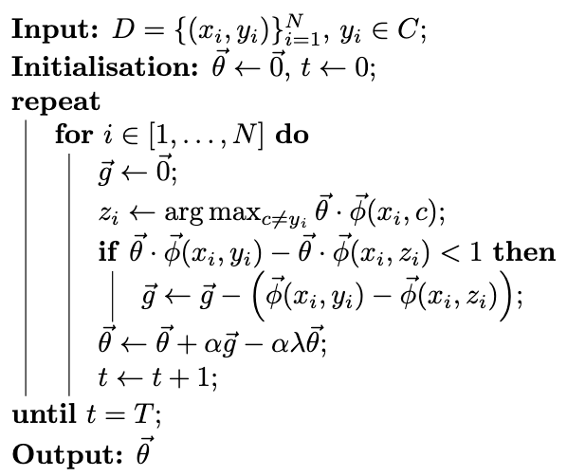
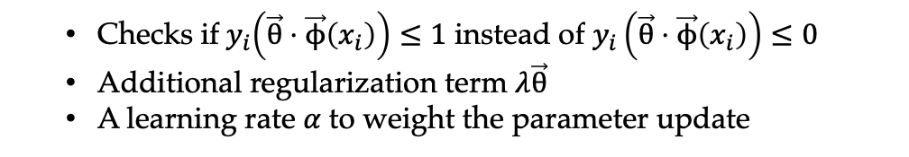
Comparing with Perceptron Multi-class Classification
multi-class SVM models
multi-class perceptron models
Checks if${ y}_{i}\left(\vec{θ}⋅\vec{ϕ}\left(x_{i}\right)\right)≤1$ instead of $y_{i}\left(\vec{θ}⋅\vec{ϕ}\left(x_{i}\right)\right)≤0$
Additional regularization term $λ\vec{θ}$
A learning rate $α$to weight the parameter update

Slide 43
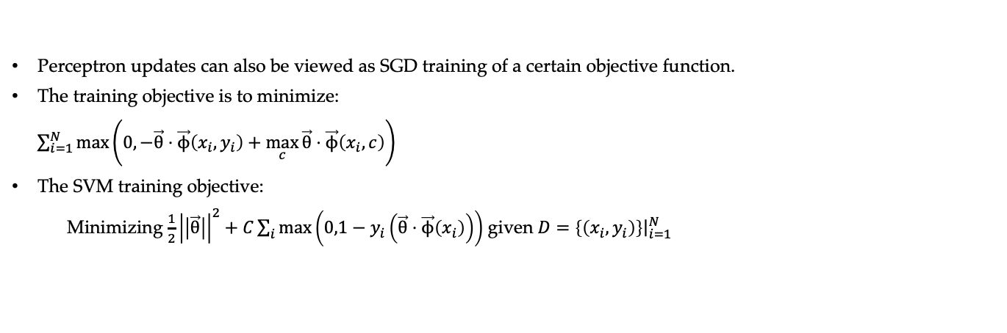
A Perceptron Training Objective Function
multi-class SVM models
multi-class perceptron models
Perceptron updates can also be viewed as SGD training of a certain objective function.
The training objective is to minimize:
$\sum_{i=1}^{N}{\max\left(0,−\vec{θ}⋅\vec{ϕ}\left(x_{i},y_{i}\right)+\left.\max_{c}{\vec{θ}}⋅\vec{ϕ}\left(x_{i},c\right)\right)\right.}$
The SVM training objective:
Minimizing $\frac{1}{2}{\left|\left|\vec{θ}\right|\right|}^{2}+C\sum_{i}{\max\left(0,1−y_{i}\left(\vec{θ}⋅\vec{ϕ}\left(x_{i}\right)\right)\right)}$ given $D={\left.\left\{\left(x_{i},y_{i}\right)\right\}\right|}_{i=1}^{N}$
Notes:
Large-margin algorithm

Slide 44
Contents
5.1 Log-Linear Models
5.1.1 Training binary log-linear models
5.1.2 Training multi-class log-linear models
5.1.3 Using log-linear models for classification
5.2 SGD training of SVMs
5.2.1 Binary classification
5.2.2 A perceptron training objective function
5.3 A Generalized Linear Model for Classification
5.3.1 Unified Online Training
5.3.2 Loss Functions
5.3.3 Regularization
5.4 Combining with Multiple Models

Slide 45
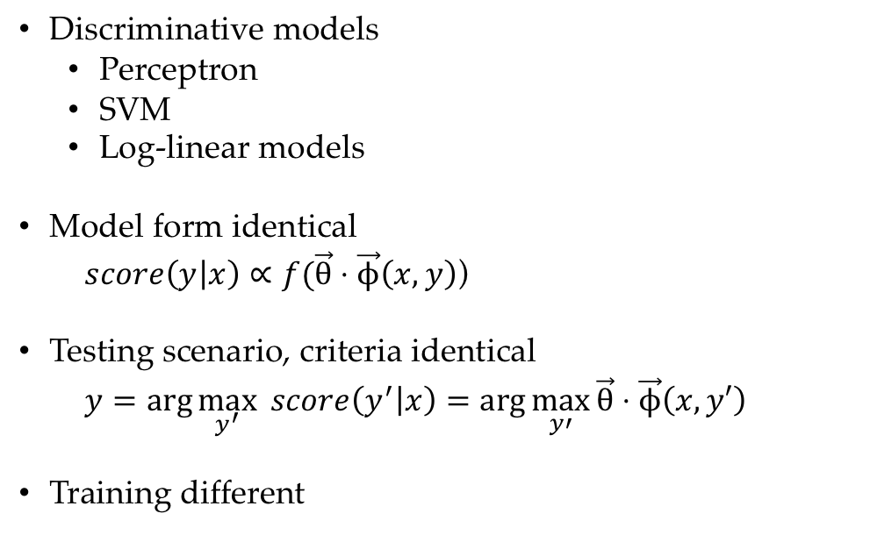
Generalized Linear Classification Model
Discriminative models
Perceptron
SVM
Log-linear models
Model form identical
$score\left(y | x\right)∝f(\vec{θ}⋅\vec{ϕ}\left(x,y\right)$)
Testing scenario, criteria identical
$y=\arg{\max_{y^{′}}{ score\left(y^{′} | x\right)}}=\arg{\max_{y′}{\vec{θ}}}⋅\vec{ϕ}\left(x,y′\right)$
Training different

Slide 46


Generalized Linear Classification Model
Model and testing (binary classification case)
parameter vector $\vec{θ}$
feature vector $\vec{ϕ}$
output class label y using the dot product $\vec{θ}⋅\vec{ϕ}$
$f −$activation function

Slide 47



Neuron
$$⋮$$
$$⋮$$
$$⟹$$

Slide 48
Contents
5.1 Log-Linear Models
5.1.1 Training binary log-linear models
5.1.2 Training multi-class log-linear models
5.1.3 Using log-linear models for classification
5.2 SGD training of SVMs
5.2.1 Binary classification
5.2.2 A perceptron training objective function
5.3 A Generalized Linear Model for Classification
5.3.1 Unified Online Training
5.3.2 Loss Functions
5.3.3 Regularization
5.4 Combining with Multiple Models

Slide 49


Unified Online Training
All by SGD training
Given a set of training data $D={\left.\left\{\left(x_{i},y_{i}\right)\right\}\right|}_{i=1}^{N}$, the algorithm goes over D for T iterations, processing each training example $\left(x_{i},y_{i}\right),$and update model parameters when necessary.

Slide 50

Unified Online Training
Parameter Update $(x_{i},y_{i})$ for perceptrons, SVMs and log-linear models

Slide 51
Unified Online Training

Slide 52
Contents
5.1 Log-Linear Models
5.1.1 Training binary log-linear models
5.1.2 Training multi-class log-linear models
5.1.3 Using log-linear models for classification
5.2 SGD training of SVMs
5.2.1 Binary classification
5.2.2 A perceptron training objective function
5.3 A Generalized Linear Model for Classification
5.3.1 Unified Online Training
5.3.2 Loss Functions
5.3.3 Regularization
5.4 Combining with Multiple Models

Slide 53


Loss Functions
SGD
loss function

Slide 54


Different Types of Loss Functions
Hinge loss: the loss functions of SVMs and perceptrons
Log-likelihood loss: the loss functions for log-linear models
0/1 loss: loss is 1 for an incorrect output and 0 for a correct output.

Slide 55

Risks
Loss functions are designed for risk minimization.
The true expected risk of a linear model with parameter can be formulated as
$$risk\left(\vec{θ}\right)=\sum_{x,y}{loss\left(\vec{θ}⋅ϕ\left(x,y\right)\right)P\left(x,y\right)},$$
which cannot be calculated, we use empirical risk as a proxy
$\tilde{risk}\left(\vec{θ}\right)=\frac{1}{N}\sum_{i=1}^{N}{loss\left(\vec{θ}⋅ϕ\left(x_{i},y_{i}\right)\right)},\left(x_{i},y_{i}\right)∈D$

Slide 56
Contents
5.1 Log-Linear Models
5.1.1 Training binary log-linear models
5.1.2 Training multi-class log-linear models
5.1.3 Using log-linear models for classification
5.2 SGD training of SVMs
5.2.1 Binary classification
5.2.2 A perceptron training objective function
5.3 A Generalized Linear Model for Classification
5.3.1 Unified Online Training
5.3.2 Loss Functions
5.3.3 Regularization
5.4 Combining with Multiple Models

Slide 57

Regularization
SVM training objective
Perception train objective:
A large element in the parameter vector $\vec{θ}$ implies higher reliance of the model to its corresponding feature, sometimes unnecessarily much.
L2 regularization : $\frac{1}{2}λ{\left|\left|\vec{θ}\right|\right|}^{2}$
and L1 regularization : $λ{\left|\left|\vec{θ}\right|\right|}_{1}$
minimize a polynomial of $\vec{θ}$ in loss functions,
reduce over-fitting of models on given training data.
Notes:
SVM is a Regularized form of perceptron

Slide 58
Contents
5.1 Log-Linear Models
5.1.1 Training binary log-linear models
5.1.2 Training multi-class log-linear models
5.1.3 Using log-linear models for classification
5.2 SGD training of SVMs
5.2.1 Binary classification
5.2.2 A perceptron training objective function
5.3 A Generalized Linear Model for Classification
5.3.1 Unified Online Training
5.3.2 Loss Functions
5.3.3 Regularization
5.4 Combining with Multiple Models

Slide 59

Ensemble Models
Ensemble approach: a combination of multiple models for better accuracies.
Voting: a simple method to ensemble different models.
Given a set of models $M=\left(m_{1},m_{2},…m_{\left|M\right|}\right)$ and output classes $C=\left(c_{1},c_{2},…,c_{\left|C\right|}\right),$ the output class y for a given input x can be decided by counting the vote (hard 0/1votes):
$v_{i}=\sum_{j=1}^{\left|M\right|}{b1\left(y\left(m_{j}\right),c_{i}\right)}$
majority voting chooses the class label that receives more than half the total votes
plurality voting chooses the class with the most votes.
More fine-grained voting methods are soft voting and weighted voting.

Slide 60

Ensemble Models
Stacking:
use the outputs of one model as features to inform another model.
Training for stacking
the stacking method trains A after B is trained.
We use K-fold jackknifing to make model B output accuracies on the training data as close to the test scenario as possible.

Slide 61
Co-training and Self-training
Data augmentation.
Semi-supervised learning use different models trained on D to predict the labels on a set of unlabeled data U, augmenting D with the outputs that most models agree on.
the more accurate the baseline models are on U, the more likely that the new data form U can be correct and useful.

Slide 62


Co-training

Slide 63

Self-training

Slide 64
Summary
Log-linear models for binary and multi-class classification
Stochastic Gradient Descent (SGD) training of log-linear models and SVMs
A generalized linear discriminative model for text classification
The correlation between SVMs, perceptrons and log-linear models in terms of training objective (loss) functions and regularization terms
Significance testing
Ensemble methods for integrating different models

